Slide 1
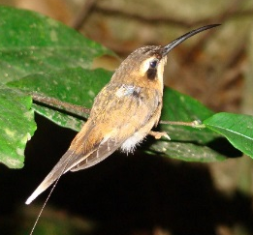
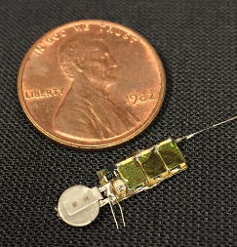
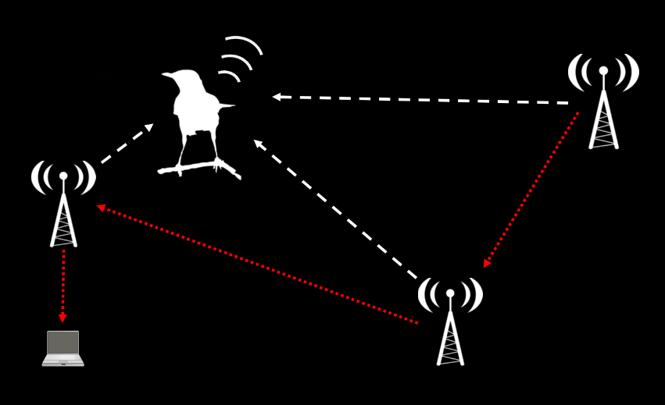
AMRUPT (Animal Movement Research Using Phase-based Trilateration)

Slide 2
This week
What did/did not work last semester?
GitHub / Blackboard organization
Proposal preparation
What is the plan for working on the proposal? Who does what? How will you coordinate?
What is the scope of the problem for Spring 2018?
What relevant resources have you found?
Brainstorm multiple solutions
Which solutions might be best?

Slide 3
Fall 2018 AMRUPT: What worked? What did not?
Equal input from all members important
Preparatory materials (e.g. slides, reports) submitted prior to meetings enables better discussion
Important not to get stalled while waiting for responses from others (e.g. TI forum moderators)
Important to have access to expertise
Other student design courses/projects with embedded system design experience
Drs. Kan, Molnar, Land, in Cornell ECE

Slide 4
This week
What did/did not work last semester?
GitHub / Blackboard organization
Proposal preparation
What is the plan for working on the proposal? Who does what? How will you coordinate?
What is the scope of the problem for Spring 2018?
What relevant resources have you found?
Brainstorm multiple solutions
Which solutions might be best?

Slide 5
GitHub AMRUPT repository
Code: a place to store all materials
Course materials: assignments, instructions, management plan
Firmware: all code, organized by general purpose

Slide 6
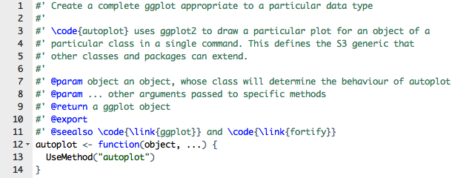
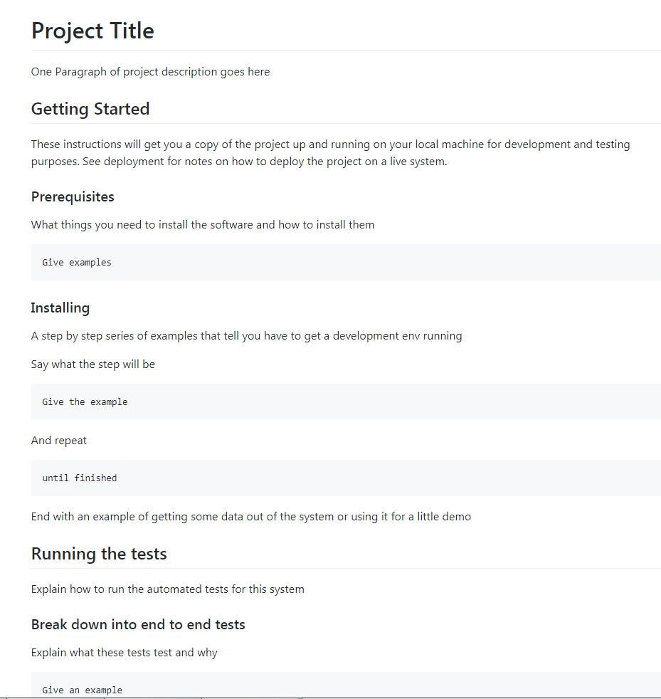
Good documentation is essential!
In-line comments
“ReadMe”file

Slide 7
GitHub AMRUPT repository
Code: a place to store all materials
Course materials: assignments, instructions, management plan
Firmware: all code, organized by general purpose
Literature: resources from others
System architecture: high-level diagram of current architecture
Tests: empirical test results, simulation files and results
Issues: a list of all of the known goals of the project
Special types: Questions, Enhancements
Milestones: Phases of the project
Project: a tool for management of progress
Columns: To do, In progress, In testing, Completed
Ordered list of current issues, and their status

Slide 8
This week
What did/did not work last semester?
GitHub / Blackboard organization
Proposal preparation
What is the plan for working on the proposal? Who does what? How will you coordinate?
What is the scope of the problem for Spring 2018?
What relevant resources have you found?
Brainstorm multiple solutions
Which solutions might be best?

Slide 9
Proposal prep: Who does what? How will you coordinate?
Define the AMRUPT Problem
Project Proposal
Khandani, 2005

Slide 10
Meeting notes on proposal structure (and who does what)
Executive summary (everyone coordinates)
Technical approach (everyone specializes on independent subsection, then integrates to make final proposal)
Obtaining I/Q data (ESSENTIAL, define options then split subsections across people)
Operation of RF switch / LFM / or LO-demod-mixer, depending on which option chosen
CC1310 firmware
Simulate required I/Q sample rates, bit-depths, susceptibility to noise for different solutions (e.g. LFM synchronization of mult. CC1310s, oversampling with RF switch on one CC1310, demod / mixer option)
Empirical test results (develop standardized tests, identify what needs to be tested)
Data transfer to RPi (IMPORTANT, but secondary to Obtaining I/Q data)
Ground-node to Mobile-node communication protocol (LOW priority, though ultimately important)
Use figures judiciously (especially flow diagrams)
Literature search (each is responsible for literature on own subsection)
Guerin, Jackson, Kelly good ref for whole-system architecture

Slide 11
This week
What did/did not work last semester?
GitHub / Blackboard organization
Proposal preparation
What is the plan for working on the proposal? Who does what? How will you coordinate?
What is the scope of the problem for Spring 2018?
What relevant resources have you found?
Brainstorm multiple solutions
Which solutions might be best?

Slide 12
Meeting notes on project scope
What is the desired functionality of the Spring 2018 AMRUPT protype?
Operates with a single tag
Only a single receiver
Detects Angle of Arrival (AOA)
Also detects distance? (Highly unlikely)
Via triangulation (requires multiple ground nodes; unlikely, but would be GREAT)
Via phase-integer-disambiguation (requires phase III approach [i.e. multi-frequency signals]; highly unlikely)
Other deliverables?
Simulations demonstrating what’s needed to reconstruct RF signal, to generate sufficiently accurate AOA estimates
Empirical test results

Slide 13
This week
What did/did not work last semester?
GitHub / Blackboard organization
Proposal preparation
What is the plan for working on the proposal? Who does what? How will you coordinate?
What is the scope of the problem for Spring 2018?
What relevant resources have you found?
Brainstorm multiple solutions
Which solutions might be best?

Slide 14
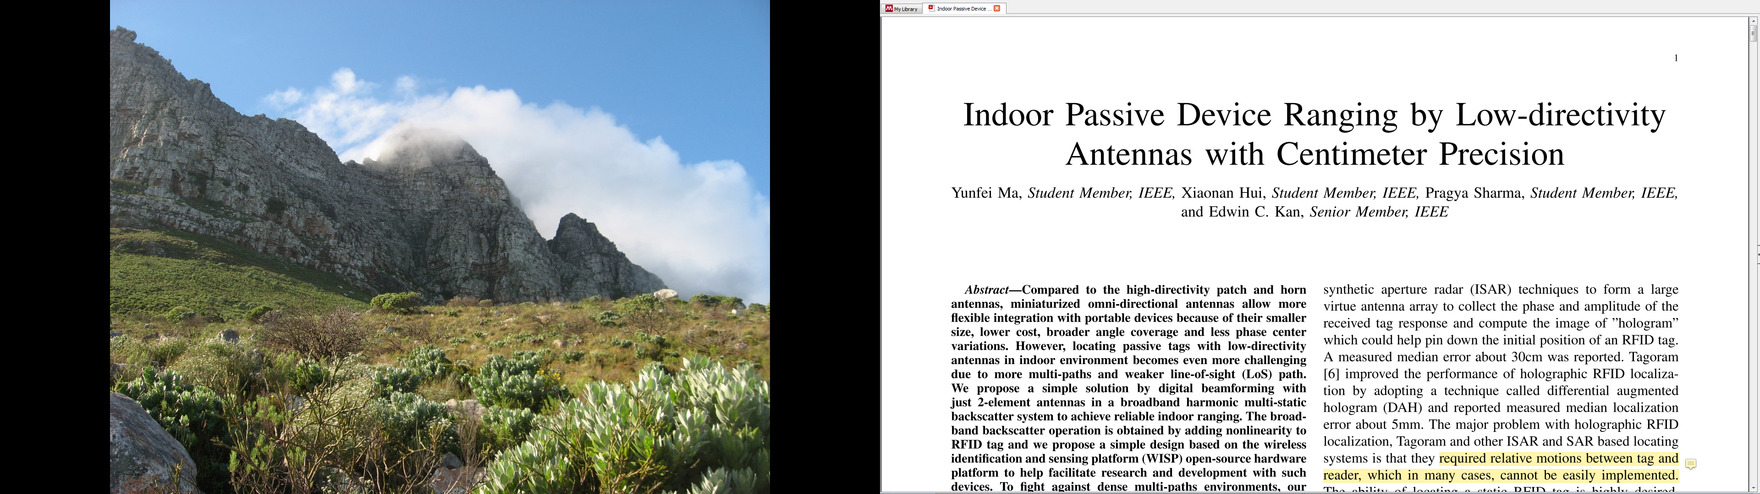
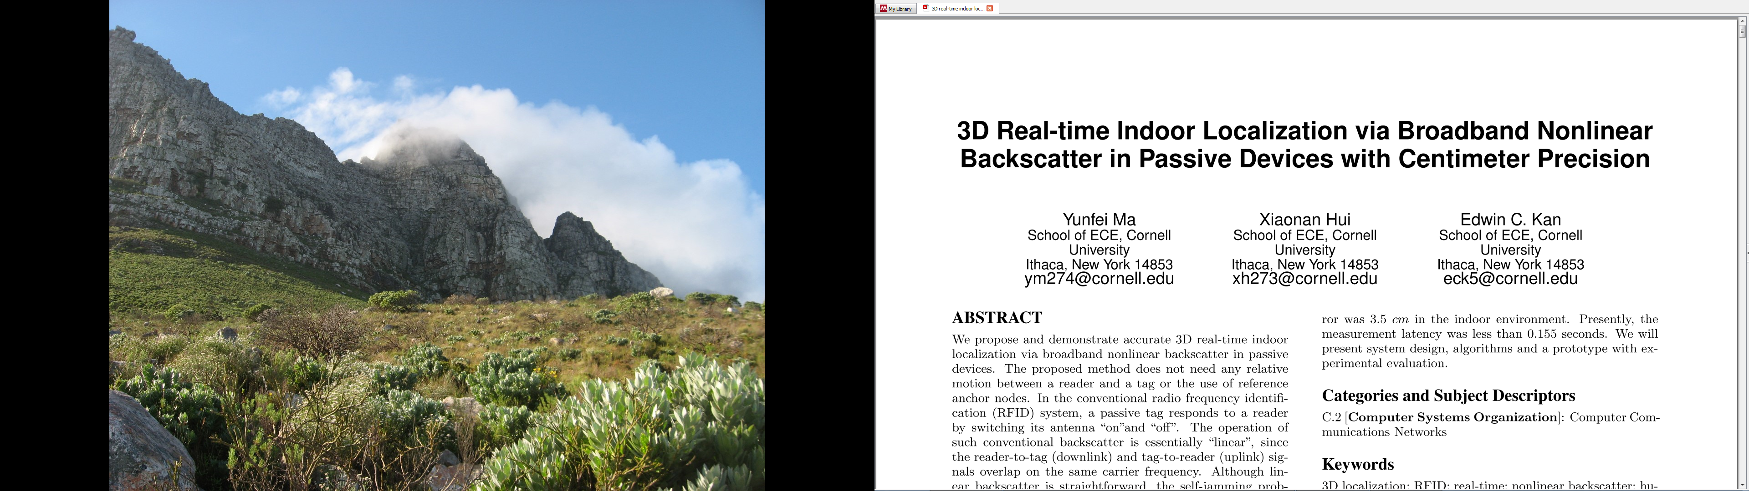
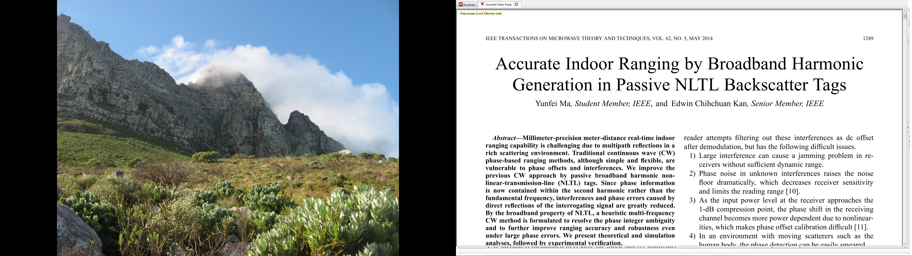

Gather pertinent information

Slide 15
This week
What did/did not work last semester?
GitHub / Blackboard organization
Proposal preparation
What is the plan for working on the proposal? Who does what? How will you coordinate?
What is the scope of the problem for Spring 2018?
What relevant resources have you found?
Brainstorm multiple solutions
Which solutions might be best?

Slide 16
This week
What did/did not work last semester?
GitHub / Blackboard organization
Proposal preparation
What is the plan for working on the proposal? Who does what? How will you coordinate?
What is the scope of the problem for Spring 2018?
What relevant resources have you found?
Brainstorm multiple solutions
Which solutions might be best?

Slide 17
For next week
Project proposal due Monday February 19th!
We will discuss your proposed management plan

